Slide 1


UNIX Standardization and Implementations
CONTENTS:
1.Introduction
2.UNIX Standardization
3.UNIX System Implementations
4. Relationship of Standards and Implementations
Presented By:
Nisarga M U
Ankitha B
Notes:
1

Slide 2
Introduction to UNIX Standardization
Background:
UNIX, originally developed in the 1970s, proliferated into many versions.
The need for standardization arose due to inconsistencies in system behavior.
Objective:
Ensure portability and compatibility of applications across different UNIX systems.
Simplify adoption by defining clear standards.
Notes:
2

Slide 3
Overview of UNIX Standards
ISO C (1989):
IEEE POSIX:
Developed as ANSI Standard X3.1959-1989, later adopted as ISO/IEC 9899:1990.
Acronym for Portable Operating System Interface.
Origin: IEEE Standard 1003.1-1988.
Focus: Portability of C programs across various operating systems.
Purpose:
Define operating system services to ensure application portability.
Features:
Standard syntax and semantics.
Includes threading (pthreads) and real-time extensions.
Inclusion of a standard library for mathematical, I/O, and utility functions.
Continuous updates: Integration of real-time features and advanced APIs.
Updates:
Enhanced numerical processing capabilities (ISO C99).
Restrict keyword for pointer optimization.
Notes:
3

Slide 4
The Single UNIX Specification
Purpose
Versions
Managed by:
Extends POSIX standards to define a superset for UNIX systems.
SUSv1 (1994): Introduced "Spec 1170," defining ~1170 system interfaces.
The Open Group (owner of the UNIX trademark).
Adds interfaces required for applications to run on certified UNIX systems.
SUSv2 (1997): Added support for threads, 64-bit processing, and real-time interfaces.
SUSv3 (2001): Integrated POSIX.1-2001, enhancing compatibility and defining rationale for design choices.
SUSv4 (2008): Consolidated updates, removed obsolete interfaces, and added modern features like asynchronous I/O and POSIX semaphores.
Notes:
4

Slide 5
Evolution of UNIX Standards
Why standards evolve
Key Milestones
Impact
To adapt to new hardware and software advancements.
1989: ISO C standard introduced.
Unified development for vendors and developers.
1990s: IEEE POSIX updates included threading and real-time extensions.
To integrate community and vendor feedback for better compatibility
Ensures backward compatibility with earlier versions like SVR3 and BSD.
2000s: SUS and POSIX combined into cohesive frameworks.
Notes:
5

Slide 6


Implementations of UNIX Standards
1
Bringing Standards to Life
Standards define interfaces; vendors implement them as operating systems.
Real-world examples help demonstrate compliance and innovation.
2
Major Implementations
System V Release 4 (SVR4):
Developed by AT&T, merges features from System V, BSD, SunOS, and Xenix.
First widely distributed UNIX version with POSIX and SUS compliance.
4.4BSD:
Developed by UC Berkeley, focused on open-source distribution.
Final release: 4.4BSD-Lite (1995), unencumbered by AT&T licensing.
FreeBSD:
Successor to 4.4BSD, with a focus on modern hardware and open-source principles.
Notes:
6

Slide 7
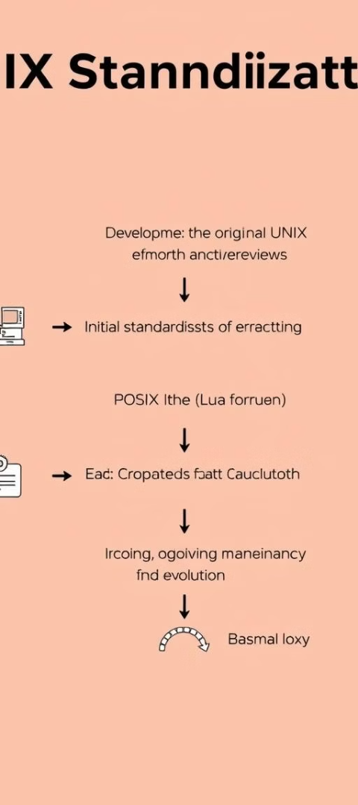



Modern UNIX-Like Systems
Linux
Created by Linus Torvalds in 1991 as an open-source alternative.
Features:
Robust community-driven development.
Rapid support for new hardware.
Widely used in servers, desktops, and embedded systems.
Example: Ubuntu (Linux kernel 3.2.0).
Mac OS X
Built on Darwin, combining FreeBSD and Mach kernel.
Certified as a UNIX system (starting with version 10.5).
Solaris
Developed by Sun Microsystems (later Oracle), based on SVR4.
Known for stability and enterprise features.
OpenSolaris initiative aimed to bring community-driven development..
Notes:
7

Slide 8

Other UNIX Systems
Examples of certified UNIX systems
AIX (IBM):
Developed by IBM for its Power Systems servers.
Features scalability, reliability, and integration with IBM middleware like DB2 and WebSphere.
Popular in enterprise environments like banking and healthcare.
HP-UX (Hewlett-Packard):
Designed for HP's proprietary hardware platforms (PA-RISC, Itanium).
Known for security (VirtualVault) and high availability through HP Serviceguard.
IRIX (Silicon Graphics):
Specialized for 3D rendering and high-performance computing.
Widely used in the entertainment industry for graphical simulations and animations.
UnixWare (SCO):
Based on System V Release 4 (SVR4), targeting business applications.
Features strong networking and scalability for enterprise solutions.
Notes:
8

Slide 9
Relationship Between Standards and Implementations
Standards:
Define interfaces but not implementations.
E.g., POSIX specifies the behavior of open() but doesn’t mandate how it is implemented.
Implementations:
Translate these standards into practical, usable systems.
Examples discussed (FreeBSD, Linux, Mac OS X, Solaris) adhere to varying degrees of compliance.
Backward Compatibility:
Vendors retain older features for compatibility (e.g., non-POSIX O_NDELAY for nonblocking I/O in Solaris).
Notes:
9

Slide 10
Conclusion
Key Takeaways:
Standardization ensures portability, compatibility, and innovation.
UNIX implementations reflect the diversity of standards adoption.
Standards continue to evolve with technology to meet modern requirements.
Notes:
10

